Slide 1
BOOSTING ALGORITHM-REGRESSION
ADA BOOST
XG BOOSTING
LG BOOSTING

Slide 2
ADA BOOST
Ada boost is a adaptive boosting.
Adaboost is a boosting ensemble model and works especially with the Decision tree
Ada boost regressor is a meta estimator.
Fitting a regressor on the original dataset
Then fits additional copies of the regressor on the same dataset

Slide 3

Ensemble Methods can be used for various reasons, mainly to:
Decrease Variance (Bagging)
Decrease Bias (Boosting)
Improve Predictions (Stacking)

Slide 4
combine weak base learners
Weak learners to combine the strong base learners
Strong learners producing a accurate model.
final model can be proven to converge to a strong learner.

Slide 5
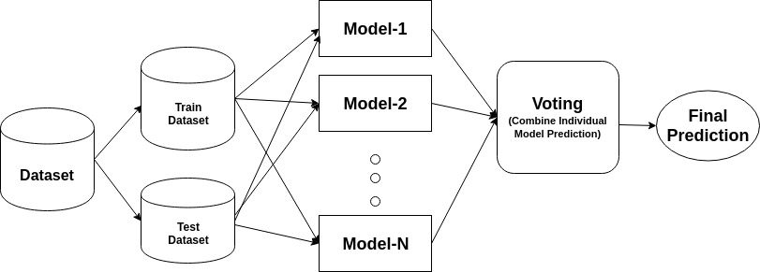

Slide 6
XG BOOST
XG boost is Extreme Gradient Boosting
XGboost is one of the ensemble learning method.
Its contains both numerical and categorical variables.
Gradient-boosting architecture and has gained popularity because of its high accuracy and scalability.
Its involves training and combining individual models to get a single prediction.
Its designed for supervised learning tasks like classification,Regression,and ranking.
XGboosting has gained popularity because of its high accuracy and scalability.

Slide 7
XG boost is a optimize the model's performance.optimized data structure called "DMatrix" store data
the regression-specific implementation of XGBoost and is used for regression problems
XG boost relationships between input features and target variables.
Its used hyperparameters effectively.
Its faster than traditional gradient boosting methods
It is highly optimized and supports parallel processing
XGBoost allows for better feature selection and understanding of model behavior.

Slide 8
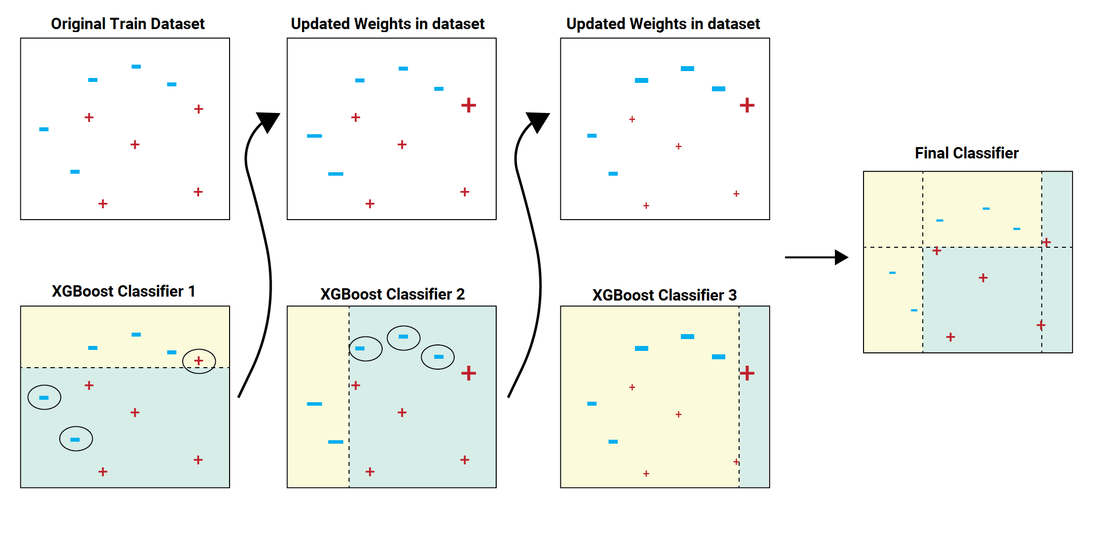

Slide 9
LG BOOST
LightGBM for regression
It is a single model is fit on all available data and a single prediction is made.
Its results given the stochastic nature of the algorithm or evaluation procedure, or differences in numerical precision.
Consider running the example a few times and compare the average outcome.
lightGBM carries out leaf wise growth that results in more loss reduction and in turn higher accuracy while being faster.

Slide 10
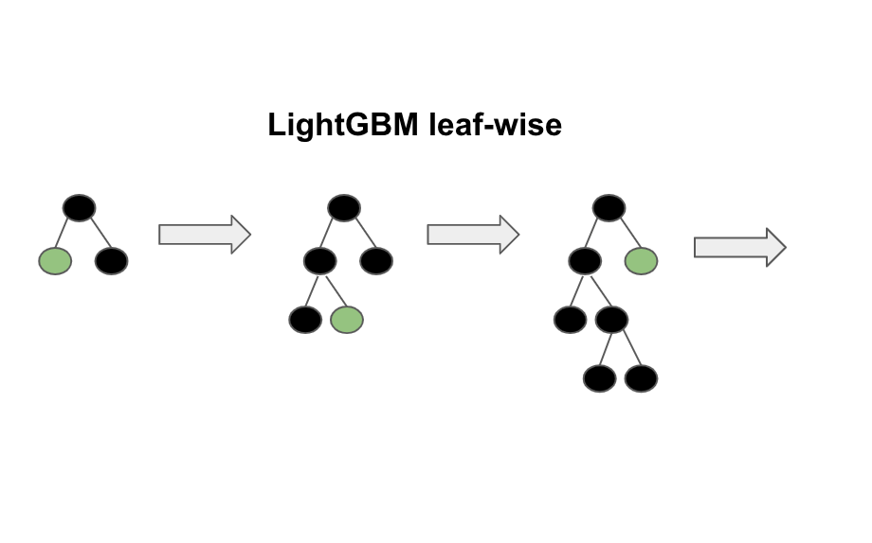
Light GBM may be a fast, distributed, highperformance gradient boosting framework supported decision tree algorithm, used for ranking, classification and lots of other machine learning tasks.

